Slide 1

PART 1 — Theory

Slide 2
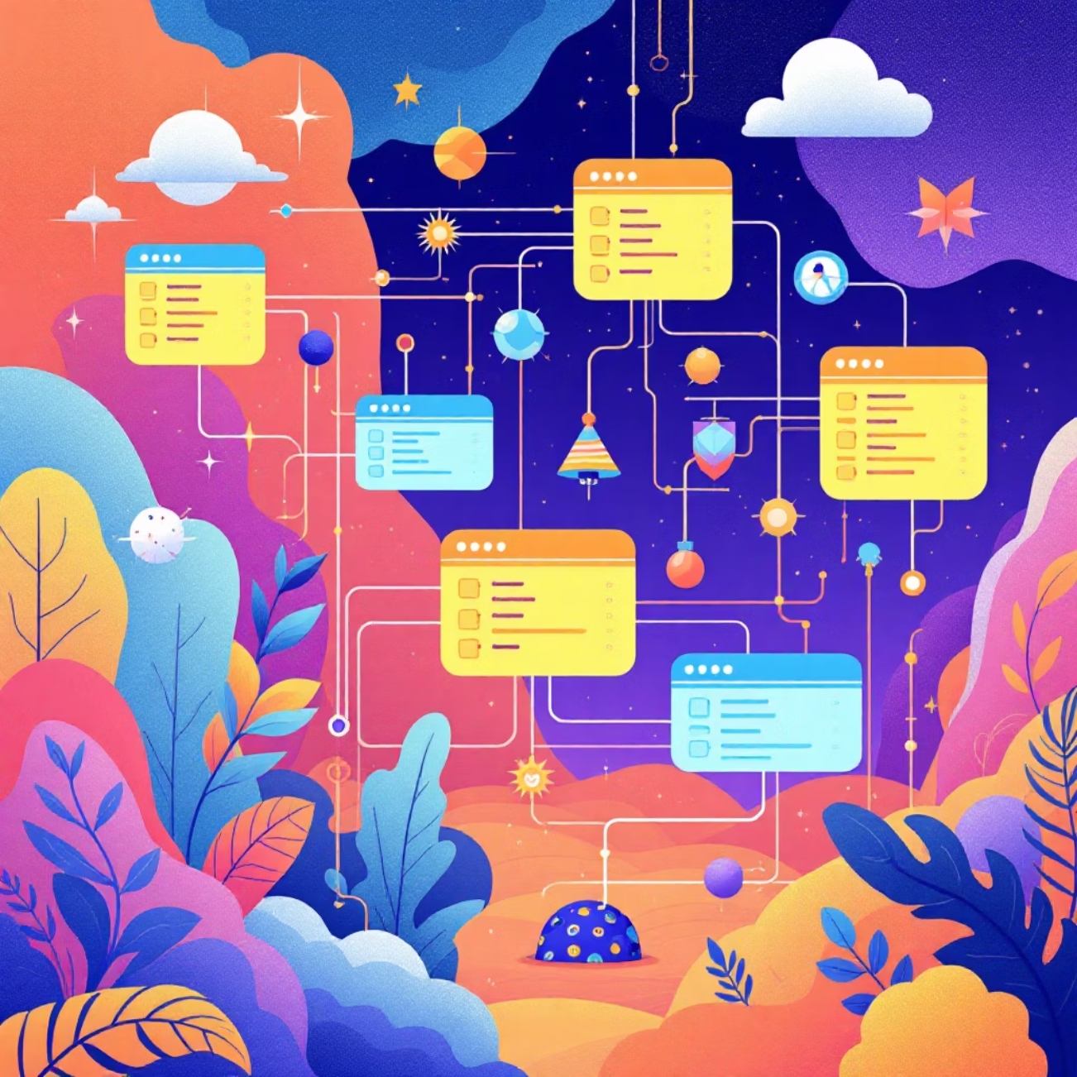

What is a Database?
A database is a structured collection of data, designed for efficient storage, management, and retrieval. It's the backbone of virtually every application and system we use daily.
Traditionally, databases have relied on SQL relational tables, organising data into predefined schemas of rows and columns. While highly effective for many use cases, this model presents challenges when dealing with highly interconnected data.
While robust, relational databases can become cumbersome when data relationships are the primary focus.

Slide 3
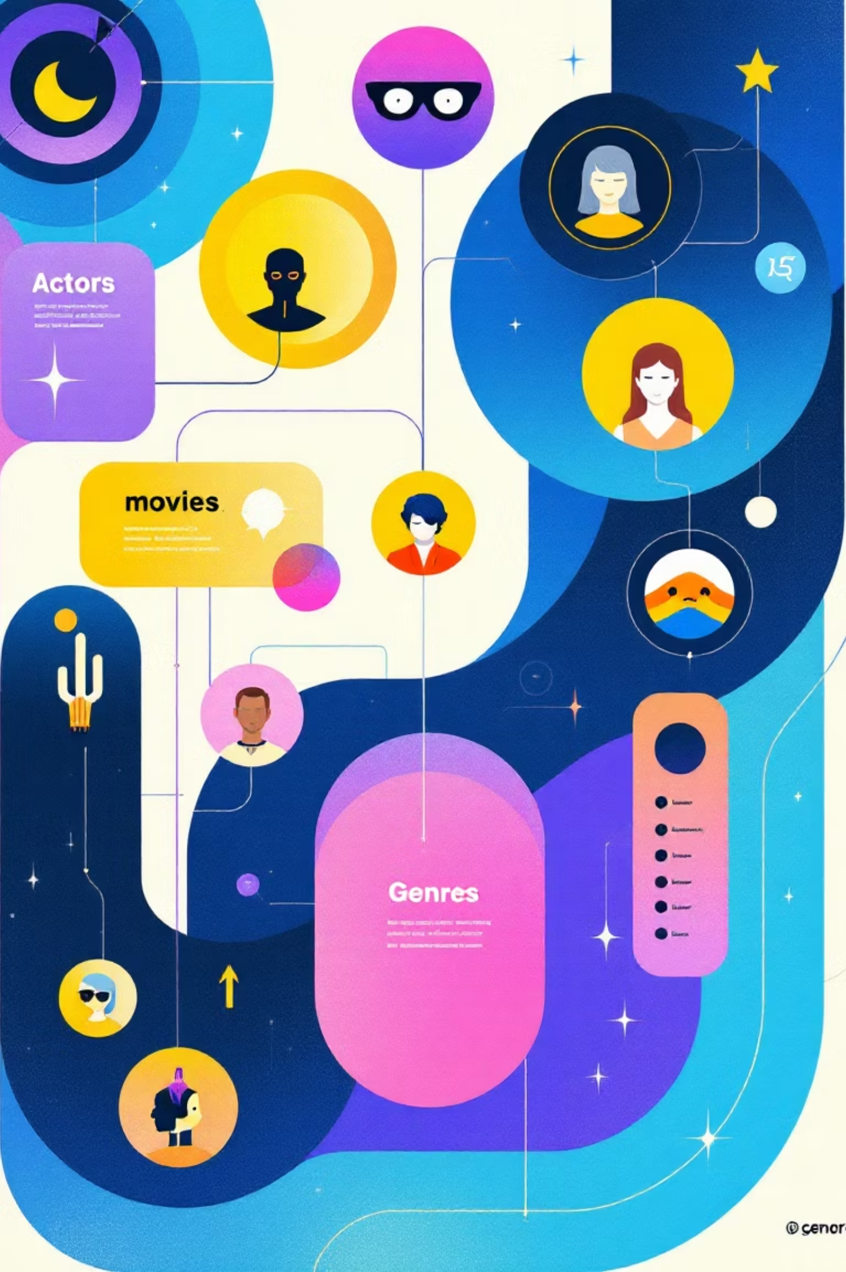
The Need for a Different Model
Consider the complex interdependencies within a recommendation system, such as one for movies:
Actor-Movie Links
Actors are related to the movies they've starred in.
Genre Classifications
Movies are categorised by various genres.
Crew Connections
Directors, producers, and writers are linked to films.
Content Similarities
Plots, themes, and similar movies create intricate webs.
Performing "multi-hop" queries—like finding other movies starring actors from a specific film, then finding other actors from those films—becomes slow and excessively complex in SQL, requiring numerous JOIN operations.

Slide 4
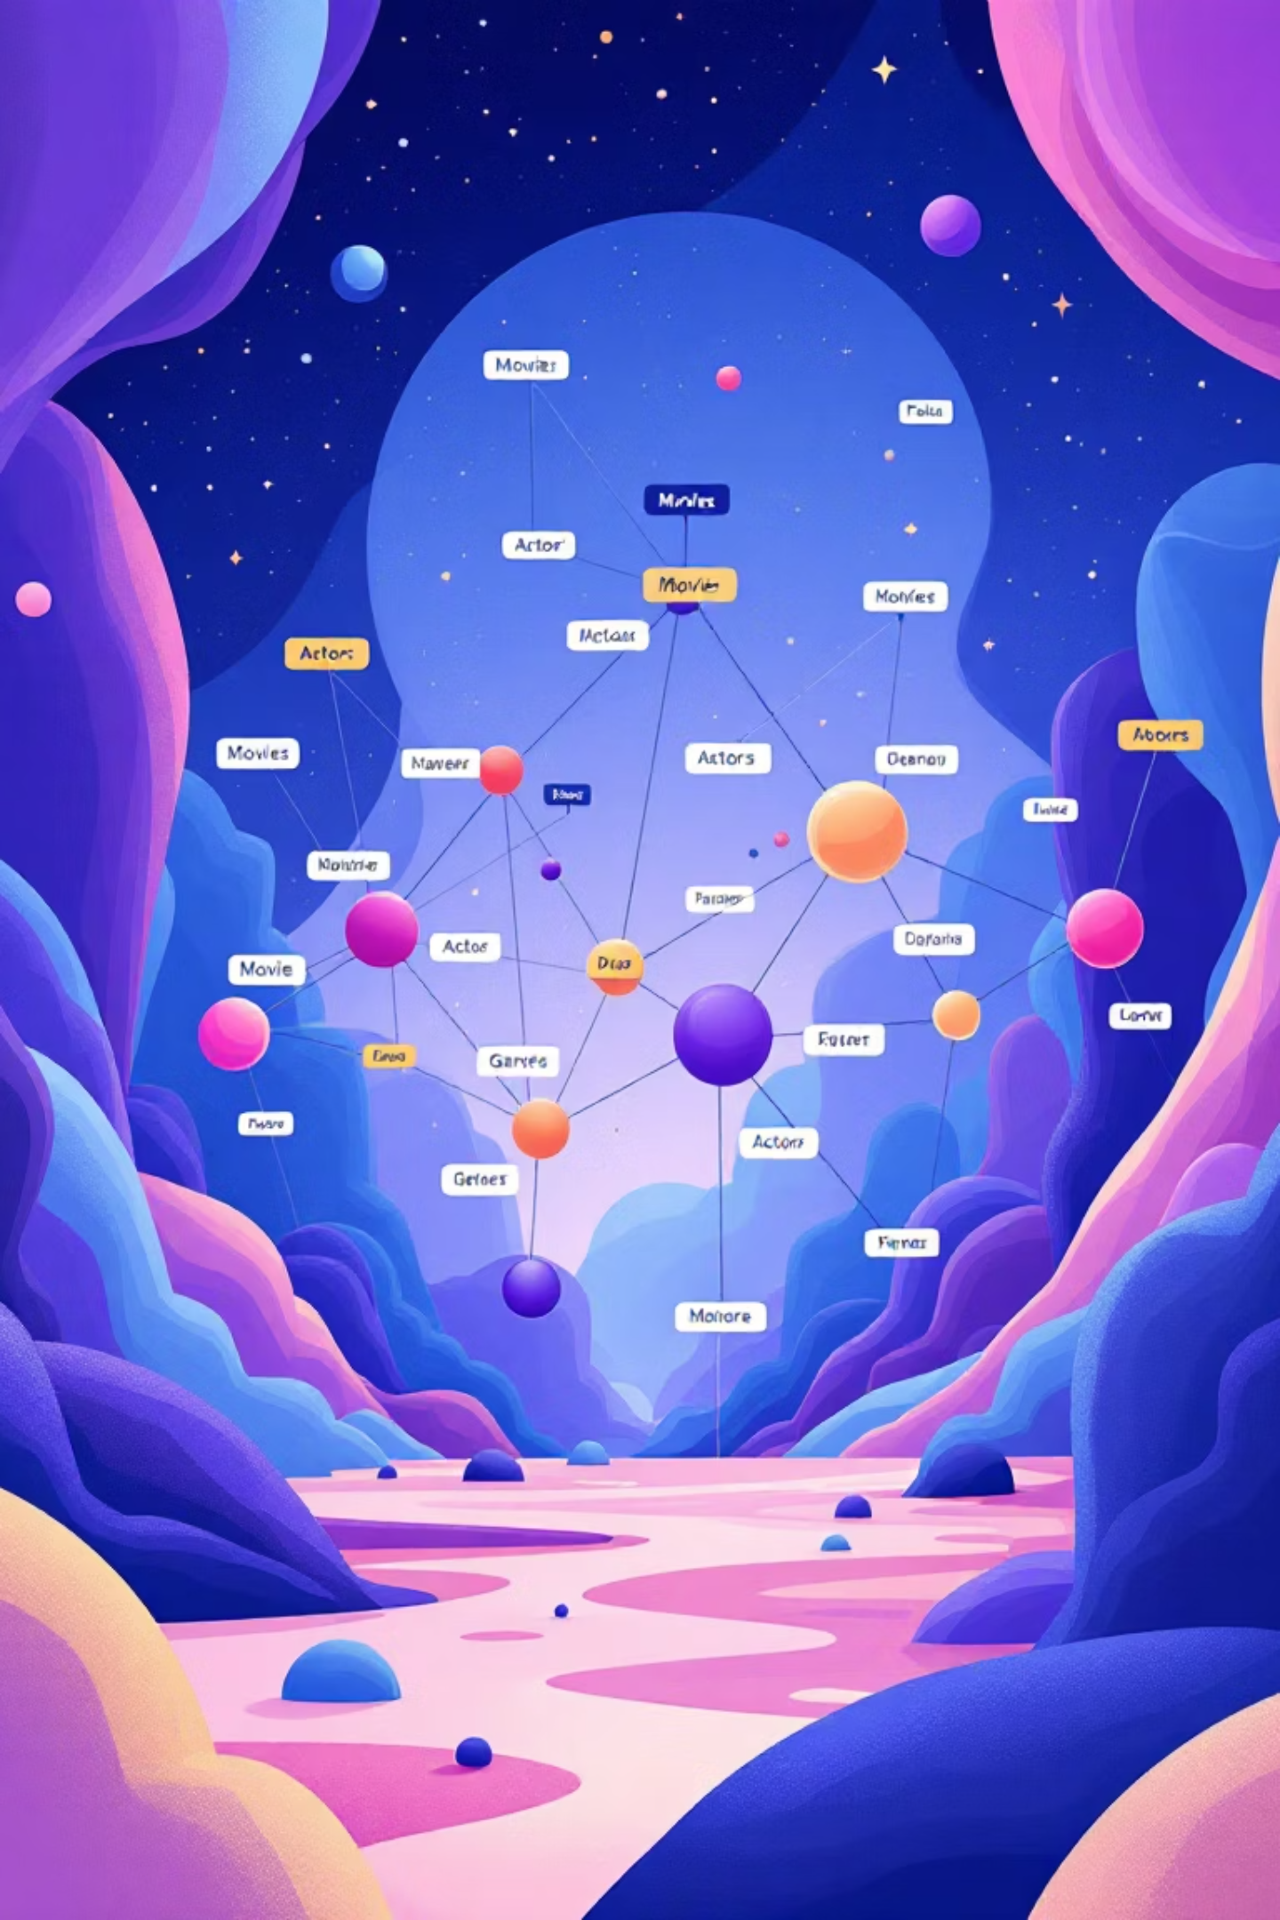
What is a Graph Database?
A graph database is a specialised database designed to store, manage, and query highly interconnected data using graph structures. It consists of three fundamental components:
Nodes
Relationships
Represent entities such as a Movie, an Actor, or a Genre. Think of them as the nouns in your data model.
Connect nodes and describe how they are associated. Examples include ACTED_IN, HAS_GENRE, or DIRECTED_BY. These are the verbs.
Properties
Key-value pairs stored on nodes or relationships, providing metadata. For example, a movie node might have rating, year, or imdb_id.
This structure directly mirrors how data is connected in the real world, with nodes forming the vertices and relationships the edges of a graph.

Slide 5

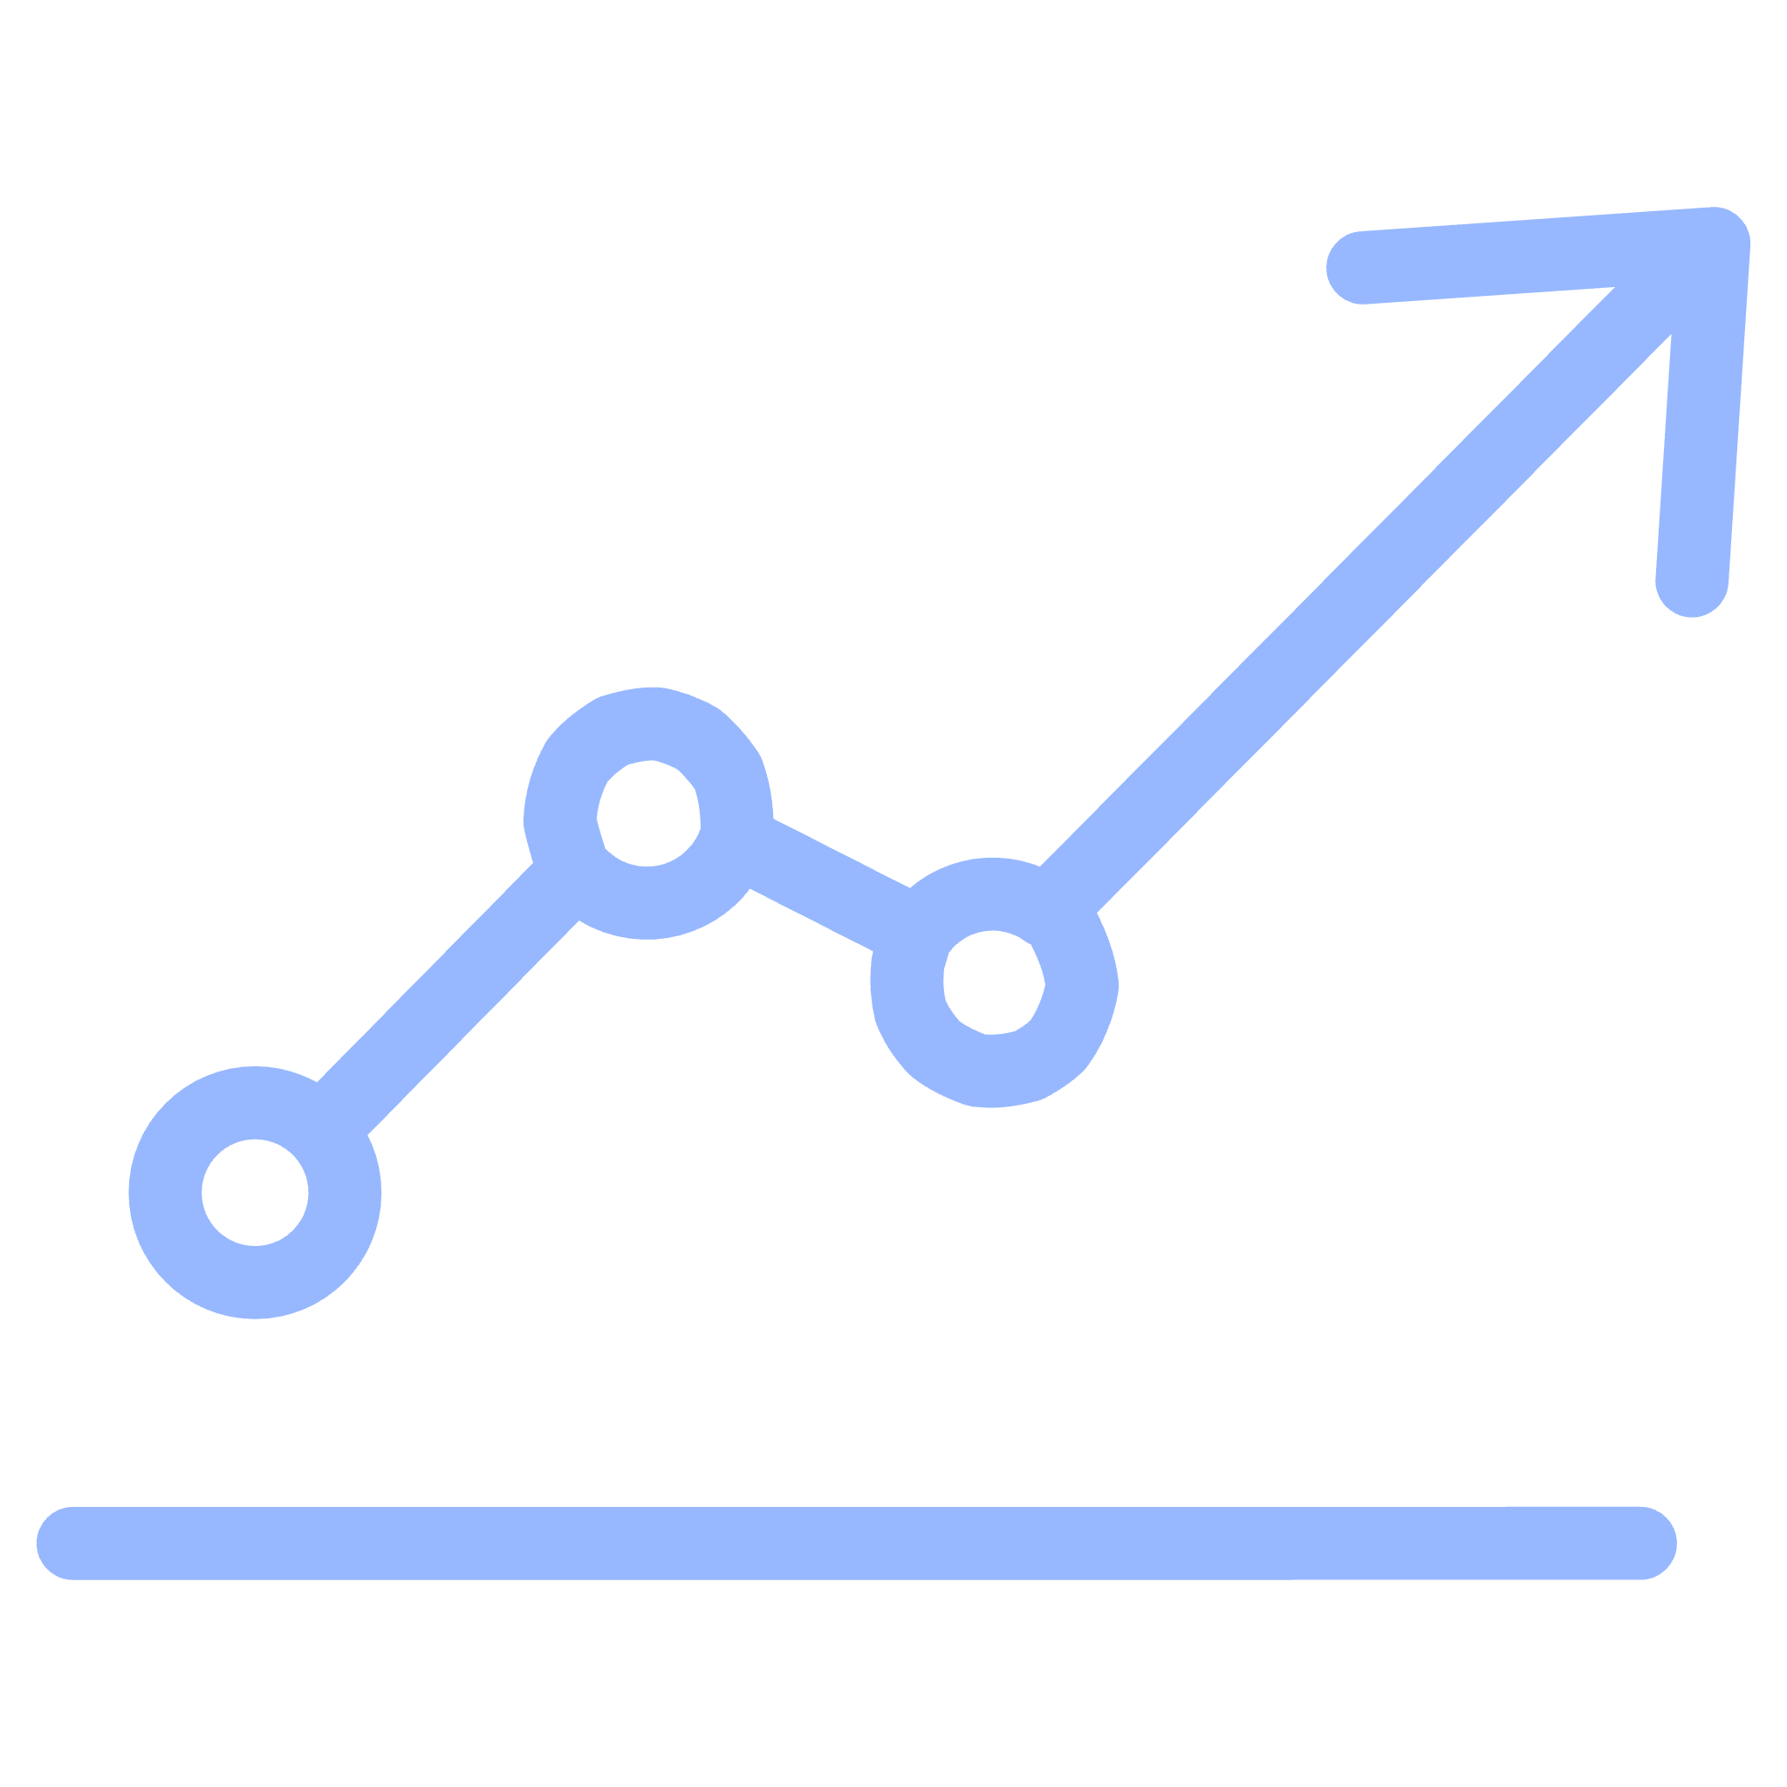
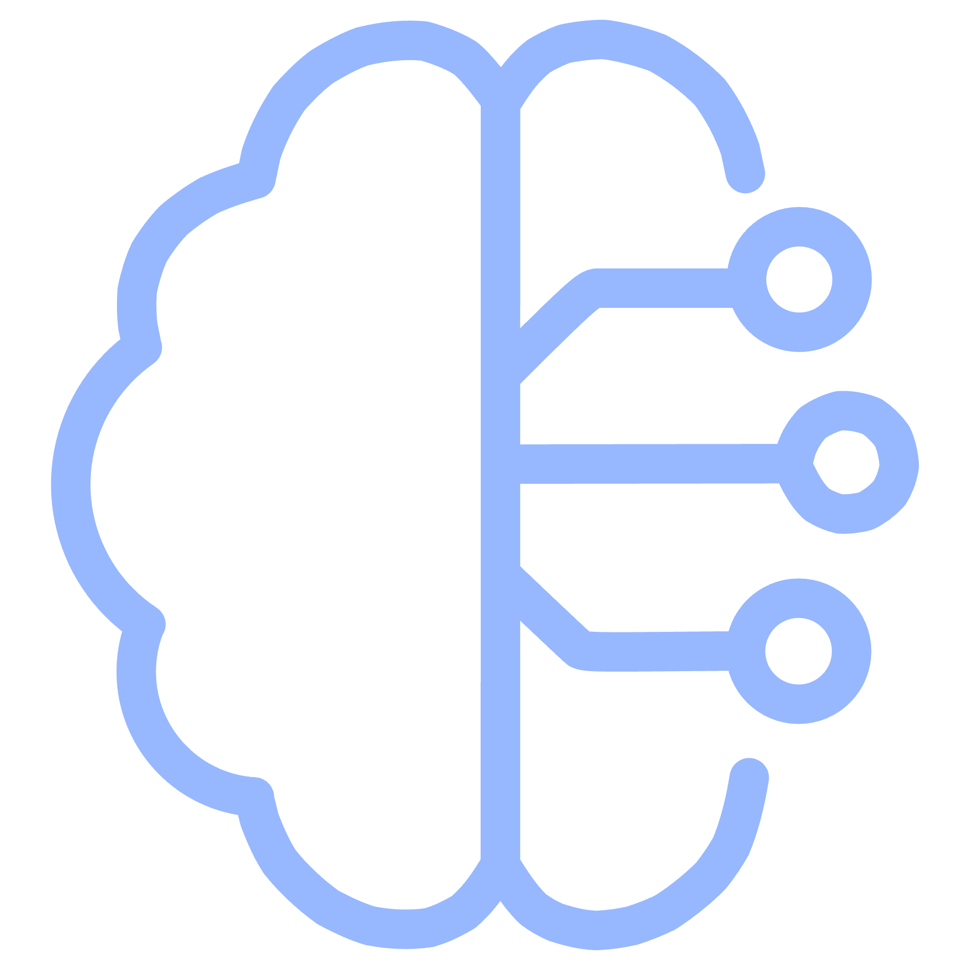


Why Use Graph Databases?
Graph databases offer compelling advantages for relationship-heavy data:
Rapid Traversal
Optimised for Recommendations
Intuitive Modelling
Very fast relationship traversal, making complex queries performant, regardless of data volume.
Easy to model real-world connections as the graph structure closely resembles human thought.
Specifically optimised for recommendation queries and social network analysis.
Declarative Query Language
Knowledge Graph Ready
Cypher query language is intuitive and powerful, designed for graphs.
Perfect for knowledge-graph style data, providing context and meaning.

Slide 6
Comparison: SQL vs Graph
Understanding the fundamental differences between traditional SQL databases and graph databases highlights their respective strengths.
Feature
SQL (Relational)
Graph DB
Relationship Traversal
Expensive (requiring complex JOIN operations)
Instant (direct pointer references)
Data Structure
Tables with rows and columns
Nodes and relationships
Best For
Transactional systems, structured records
Recommendations, social networks, fraud detection
Querying
JOIN-based, imperative
Pattern-based, declarative

Slide 7
What is Neo4j?
Neo4j stands as the undisputed #1 graph database in the world, offering a robust and scalable platform for managing connected data.
High-Performance Engine
1
Engineered for speed and efficiency when traversing vast networks of relationships.
Cypher Query Language
2
Its intuitive, declarative language makes querying graphs simple and powerful.
Cloud-Native Option
3
Neo4j Aura provides a fully managed cloud service for easy deployment and scaling.
Rich Visualisation Tools
4
Built-in tools allow for interactive exploration and understanding of your graph data.
Extensive Integrations
5
Seamlessly integrates with popular languages and frameworks like Python and FastAPI.

Slide 8
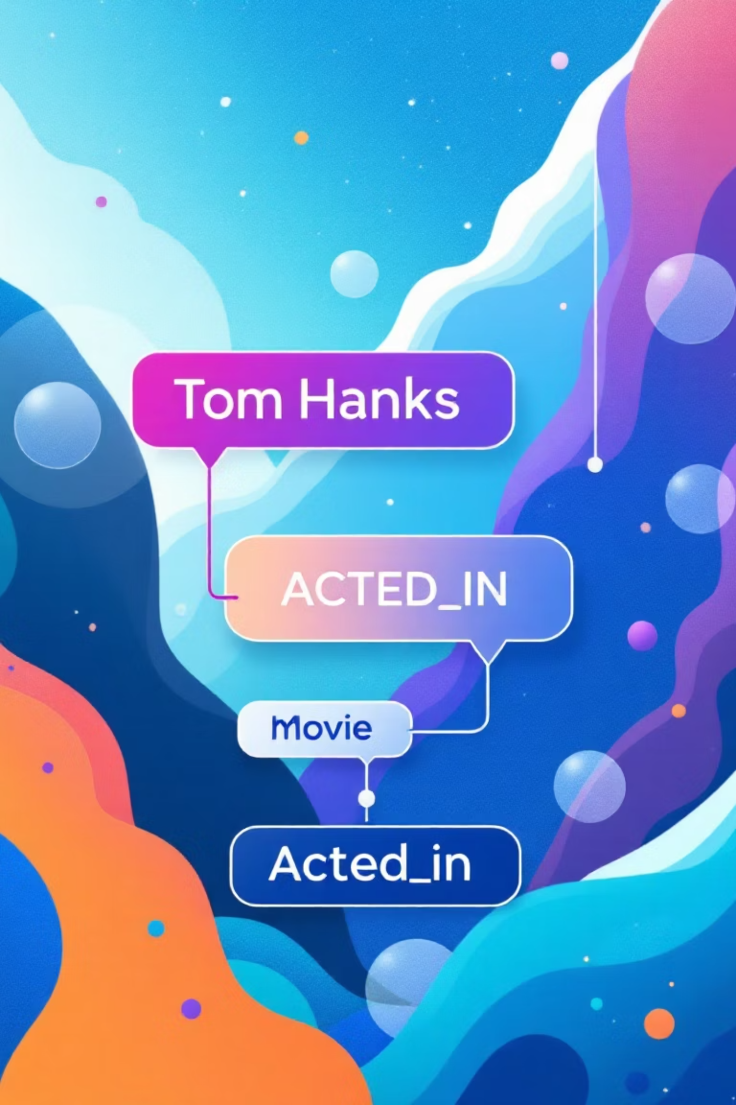
Cypher Query Example
Cypher, Neo4j's powerful and declarative query language, is designed to be highly readable and expressive. It mimics the visual structure of a graph, making it easy to understand even for those new to graph databases.
MATCH (a:Actor)-[:ACTED_IN]->(m:Movie) WHERE a.name = "Tom Hanks" RETURN m.title;
This query succinctly expresses: "Find an Actor node connected by an ACTED_IN relationship to a Movie node, where the Actor's name is 'Tom Hanks', and then return the titles of those Movies."
Very intuitive: The syntax visually represents the relationship pattern, making complex queries accessible and easy to reason about.

Slide 9

PART 2 — Use Cases

Slide 10
Usecases
Recommendation systems
2. Path Finding
3. Knowledge Graphs
4. Fraud Detection
5. Supply Chain Management

Slide 11
Recommendation System Logic
We leveraged Neo4j's capabilities to generate sophisticated movie recommendations based on multiple criteria:
1. Actor-based Similarity
1
Identifying movies that share a significant number of actors.
2. Genre-based Similarity
2
Finding movies that belong to similar or shared genres.
3. Content-based Similarity
3
Utilising advanced techniques like embeddings to gauge plot and thematic relevance.
Graph databases excel at solving these types of problems:
Efficiently finding "movies connected through X hop" in a network.
Discovering complex "patterns of relationships" within the data.
Identifying "communities or clusters of similar nodes" for targeted recommendations.
This makes them the perfect foundation for building powerful and dynamic recommendation engines.

Slide 12
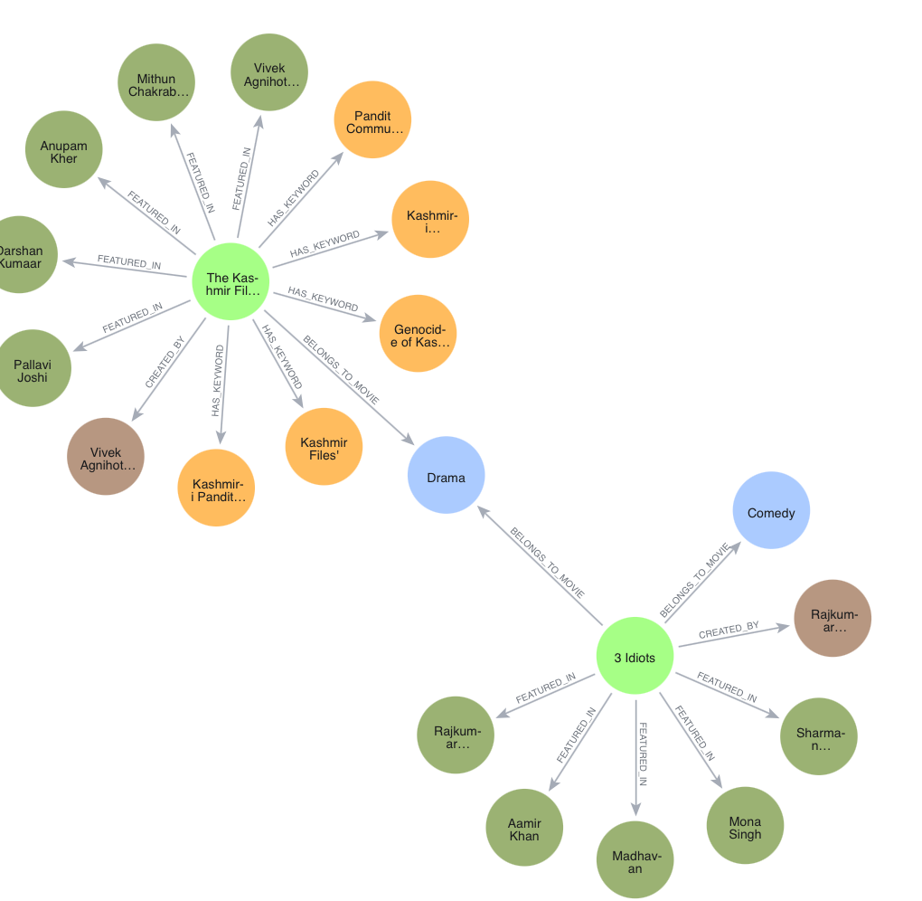
Example

Slide 13
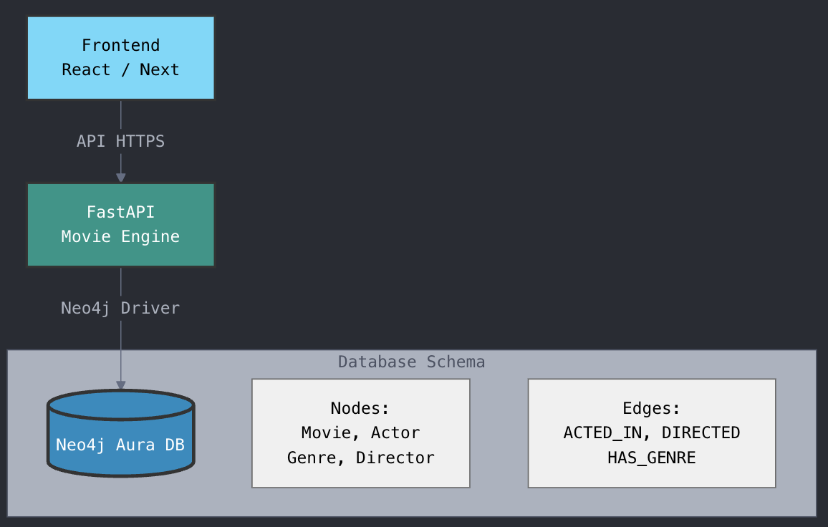
Architecture Diagram

Slide 14
Deliverables
Team #13
Repo: https://github.com/rodynaamrfathy/Graph-Based-Movie-Recommendation
Webapp: http://localhost:5173
Demo Link:
Noureen Mohamed
20226114
Omar Ahmed
20226067
Mohamed Khaled
20225056
Rodyna Amr
20227012
Lodgy Magdy
20226080

